Slide 1
7COM1025 Programming for Software Engineers
7COM1025 Programming for Software Engineers
Junit test
Dr Hui Cheng
Email: h.cheng2@herts.ac.uk

Slide 2
Why software testing?
Because we all make mistakes.
Some of those mistakes are unimportant,
but some of them are expensive or dangerous.
to point out the defects and errors that were made during the development phases.
to ensure the Quality of the product and gain the customers' confidence
to require lower maintenance cost and hence result into more accurate, consistent and reliable results.
Effective performance of software applications/products
to ensure that bugs and issues are detected early in the life cycle of the product or application. Otherwise, it can be very expensive to fix them since this might require redesign, re-implementation and retesting of the application.

Slide 3
Why?
In short, to produce better code
Preconditions
Working code
Good set of unit tests
A little test, a little code, a little test, a little code…

Slide 4
What should be tested ?
Test for boundary conditions
Test for both success and failure
Test for general functionality
Etc..

Slide 5
What is test case
Test Case
“A test case is a small unit of code that tests a
specific method”
INPUT: Actions sent to System Under Test (SUT).
OUTPUT: Responses expected from SUT.
VALIDATION: To Check the Test, was successful or not?

Slide 6
A good test case
A good test case satisfies the following criteria:
Reasonable probability of catching an error
Does interesting things
Doesn’t do unnecessary things
Neither too simple nor too complex
Not redundant with other tests
Makes failures obvious
Mutually Exclusive, Collectively Exhaustive

Slide 7
Test case verdict
A verdict is the declared result of executing a single test.
We can get the verdict after the assertion statement.
Pass: the test case achieved its intended purpose, and the
software under test performed as expected.
Fail: the test case achieved its intended purpose, but the software under test did not perform as expected.
Error: the test case did not achieve its intended purpose.
Potential reasons:
An unexpected event occurred during the test case. The test case could not be set up properly.

Slide 8
Test case design technique
Test case design techniques can be broadly split into two main categories
Black box (functional)
White box (structural)

Slide 9
Black box testing
Input
Black box
Output
... determined by requirements
Actual output
compared
with
required
BLACK BOX TESTING, also known as Behavioural Testing, is a software
Testing method in which the internal structure/design/implementation of the
item being tested is not known to the tester.

Slide 10
White Box tests
Input
Output
Developer’s tests
Targeted at the underlying complexity of the software
Intimate knowledge of implementation
Good for testing individual functions
Test the implementation and design
Notes:
White box: “Developer’s tests” – typically confirm known-good behavior, or target implementation-specific weaknesses.
In general, good for function-level tests.
Too much knowledge can sometimes be a bad thing. If the code “looks good”, there is a temptation to avoid tests because they “look like they should pass”.
Underlying complexity: The software may try to appear simple to the user, but the underlying implementation details are often extremely complex. By testing with knowledge of the implementation, testers can create tests that are designed to exacerbate the internal details of the software that the user is normally hidden from. This includes interactions with other software components, etc. These bugs often occur because the capabilities of the underlying software are often much larger than the features exposed directly to the user. Since the user doesn’t (normally) exercise many of these capabilities, they often contain many bugs!
Grady Booch: “It is our job … ultimately to build the illusion of simplicity.” This illusion is extremely complex! (Layer on layer, abstraction on abstraction)
Actual simplicity is (often) not very useful!
Implementation: tests are directed at specific weaknesses in the design (e.g., target the worst-case scenario for sorts, the slowest times for search, the most memory-intensive for copies, etc.)
Design: tests use inputs chosen to show the code works for “almost all possible” ranges of input (specifically targets “edge cases”, etc.)

Slide 11
Equivalence partitioning
Black box test technique
Divide the input range into a number of equivalence partitions
Create a test for at least one input from each equivalence partition
Equivalence partition – aims to reduce the number of redundant test cases by eliminating those that generate the same output and do not necessarily reveal defects in a program functionality
An application that reads in images of only three types, .jpeg, .gif and .png, then three sets of valid equivalent classes can be identified.
An image with a .jpeg extension
An image with a .gif extension
An image with a .png extension

Slide 12
Another Example
Assume that the application accepts an integer in the range 100 to 999
Valid Equivalence Class partition: 100 to 999 inclusive.
Non-valid Equivalence Class partitions: less than 100, more than 999, decimal numbers and alphabets/non-numeric characters.

Slide 13
Types of Tests
Unit
Smallest useful piece of software, and often has the smallest tests
Individual classes or types
Component
Group of related classes or types
Integration
Interaction between classes / subsystems
Notes:
These “types” are certainly not exhaustive, but it is useful to know how tests are often broken down conceptually.
Unit: Smallest useful piece of software, and often has the smallest tests. Often (but not always), these are “sanity checks” to make sure code changes haven’t broken anything obvious.
Component: Test the behavior of a class (or groups of related classes) on a whole. Should cover all methods / properties / etc., and should cover as many “valid” inputs as possible.
Integration: Test behavior of components interacting with each other. These tests should cover more “unusual” scenarios, such as invalid inputs. This is a good place to test for classes being “time sensitive” – that is, whether method calls work independent of when they occur.
Integration testing may also include UI testing, end-to-end scenarios, etc.

Slide 14
Unit Testing
A unit is the smallest testable part of an application.
The testing of single entity (class or method).
Unit testing is very essential to every software company and developer.
Unit test explores a particular aspect of the behavior of the Class Under Test (CUT)

Slide 15


Unit Testing
Required Input and Expected Output.
Input
Output
Unit
Unit testing is particularly important when software requirements change frequently (e.g., zuul)
Code often has to be refactored to incorporate the changes
Unit testing helps ensure that the refactored code continues to work

Slide 16
What is an XUnit framework?
A standardized set of language-independent concepts and constructs for writing and running unit tests
There is an XUnit framework for virtually every language
Examples: JUnit for Java, CppUnit for C++, PHPUnit for PHP, UTPL/SQL for Oracle SQL
Traditionally open-source
All support certain constructs:
TestCase and TestSuite are well-defined entities
The assertion syntax follows rough standards, e.g. assertEquals(comment, expected, actual)
All provide a TestRunner program to run tests

Slide 17


JUnit
A unit test framework for Java
Authors: Erich Gamma, Kent Beck
Objective:
“If tests are simple to create and execute, then programmers will be more inclined to create and execute tests.”
Web site: junit.org

Slide 18
JUnit
JUnit is a framework for writing unit tests
A unit test is a test of a single class
A test case is a single test of a single method
A test suite is a collection of test cases
JUnit provides a basic class called TestCase (public abstract).
The tester
Extends the TestCase class for each test case. 10 extensions for 10 test cases.
Alternatively, extend TestCase to have 10 methods for 10 test cases.

Slide 19
JUnit
Reports the number of defects graphically.
May create many tests for each method.
Cheaply and incrementally build a test suite that helps to:
measure your progress,
spot unintended side effects.
focus your development efforts.

Slide 20
What is a testing framework?
A test framework provides reusable test functionality which:
is easier to use (e.g. don’t have to write the same code for each class)
is standardised and reusable
provides a base for regression tests

Slide 21
Regression testing
New code and changes to old code can affect the rest of the code base
Does new functionality disturb existing functionality?
Keep old test suite + old results … rerun.
Regression testing is the process of testing changes to computer programs to make sure that the older programming still works with the new changes.
Regression testing is a normal part of the program development process and, in larger companies, is done by code testing specialists.

Slide 22
What JUnit does
JUnit runs a suite of tests and reports results
For each test in the test suite:
JUnit calls setUp()
This method should create any objects you may need for testing

Slide 23
What JUnit does…
JUnit calls one test method
The test method may comprise multiple test cases; that is, it may make multiple calls to the method you are testing
The setUp() method ensures you entered the test method with a virgin set of objects; what you do with them is up to you
JUnit calls tearDown()
This method should remove any objects you created

Slide 24
Creating a test class in JUnit
Define a subclass of TestCase
Override the setUp() method to initialise object(s) under test.
Override the tearDown() method to release object(s) under test.
Define one or more public testXXX() methods that exercise the object(s) under test and assert expected results.
Define a static suite() method that creates a TestSuite containing all the testXXX() methods of the TestCase.

Slide 25
Fixtures
A fixture is just some code you want to run before every test
You get a fixture by overriding the method
protected void setUp() { …}
The general rule for running a test is:
protected void runTest() { setUp();
<run the test>
tearDown(); }
so we can override setUp and/or tearDown, and that code will be run prior to or after every test case

Slide 26
Implementing setUp() method
Override setUp() to initialise the variables, and objects
Since setUp() is your code, you can modify it any way you like (such as creating new objects in it)

Slide 27
Implementing the tearDown() method
In most cases, the tearDown() method doesn’t need to do anything
The next time you run setUp(), your objects will be replaced, and the old objects will be available for garbage collection
Like the finally clause in a try-catch-finally statement, tearDown() is where you would release system resources (such as streams)

Slide 28
The structure of a test method
A test method doesn’t return a result
If the tests run correctly, a test method does nothing
If a test fails, it throws an AssertionFailedError
The JUnit framework catches the error and deals with it

Slide 29
“Rhythm” of an Automated Test
Setup (most of it in a separate method)
Exercise (call) production class(es)
Assertion(s); true => silence; false => fail
Teardown (if needed, in a separate method)

Slide 30
Automation Test
Taking tool support and executing the test cases by using automation tool is known as automation testing.
Fast Automation runs test cases significantly faster than human resources.
Less investment in human resources: Test cases are executed by using automation tool so less tester are required in automation testing.
More reliable: Automation tests perform precisely same
operation each time they are run.
Programmable: Testers can program sophisticated tests to bring out hidden information.

Slide 31
Example: Counter class
For the sake of example, we will create and test a trivial “counter” class
The constructor will create a counter and set it to 0
The increment method will add one to the counter and return the new value
The decrement method will subtract one from the counter and return the new value
Don’t be alarmed if, in this simple example, the JUnit tests are more code than the class itself

Slide 32
JUnit tests for Counter
public class CounterTest extends junit.framework.TestCase { Counter counter1;
public CounterTest() { } // default constructor
protected void setUp() { // creates a (simple) test fixture counter1 = new Counter(); }
protected void tearDown() { } // no resources to release
public void testIncrement() { assertTrue(counter1.increment() == 1); assertTrue(counter1.increment() == 2); }
public void testDecrement() { assertTrue(counter1.decrement() == -1); } }

Slide 33
Example: ShoppingCartTest
import junit.framework.TestCase;
public class ShoppingCartTest extends TestCase {
privateShoppingCart cart;
private Product book1;
protected void setUp() {
cart = new ShoppingCart();
book1 = new Product (“myTitle”, “500SEK”);
cart.addItem(book1);
}

Slide 34
protected void tearDown() {
// release objects under test here, if necessary
}
public void testEmpty() {
cart.empty();
assertEquals(0, cart.getItemCount() );
}

Slide 35
public void testAddItem() {
product book2 = new Product(“title2””650SEK”);
cart.addItem(book2);
double expectedBalance =
book1.getPrice() + book2.getPrice();
assertEquals(expectedBalance, cart.getBalance(), 0.0);
assertEquals(2, cart.getItemCount() );
}
public void testRemoveItem() throws productNotFoundException {
cart.removeItem(book1);
assertEquals(0, cart.getItemCount() );
}

Slide 36
public void testRemoveItemNotInCart() {
try {
Product book3 = new Product(“title3”, “100SEK”);
cart.removeItem(book3);
fail(“Should raise a ProductNotFoundException”);
}
catch(ProductNotFoundException expected) {
// passed the test!
}
}
} // of class ShoppingCartTest

Slide 37
fail() throws an assertion error unconditionally. This might be helpful to mark an incomplete test (work in progress) or to ensure that an expected exception has been thrown.
Examples below use fail()
Source: (Foo.java)
public class Foo {
void method(int x) throws IllegalArgumentException {
if (x < 0) {
throw new IllegalArgumentException();
}
}
}

Slide 38
Unit Test Source: (UnitTest.java)
import static org.junit.Assert.fail;
import org.junit.Before;
import org.junit.Test;
public class UnitTest {
Foo foo;
@Before
public void setUp() {
foo = new Foo();
}
@Test
public void failExampleTest() {
if(foo == null){
fail("foo is null"); //incomplete test
}
try {
foo.method(-1);
fail("Should of thrown an IllegalArgumentException"); //expected excep
} catch (IllegalArgumentException e) {
// handle exception
}
}
}
Notes:
expected exception

Slide 39
Test suites
A group of tests.
A test suite is a convenient way to group together tests that are related.
For example, if you don’t define a test suite for a test class, JUnit automatically provides a test suite that includes all tests found in the test class.

Slide 40
An example test suite
import TestMe; // TestMe is the class whose methods are going to be tested.
import junit.framework.*; // This contains the TestCase class.
public class MyTestSuite extends TestCase { // Create a subclass of TestCase
public void MyTest1() { // This method is the first test case
TestMe object1 = new TestMe( ... ); // Create an instance of TestMe with desired params
int x = object1.Method1(...); // invoke Method1 on object1
assertEquals(365, x); // 365 and x are expected and actual values, respectively.
}
public void MyTest2() { // This method is the second test case
TestMe object2 = new TestMe( ... ); // Create another instance of
// TestMe with desired parameters
double y = object2.Method2(...); // invoke Method2 on object2
assertEquals(2.99, y, 0.0001d); // 2.99 is the expected value;
// y is the actual value;
// 0.0001 is tolerance level
}
}

Slide 41
Assertions
A package of methods that checks for various properties:
“equality” of objects //assertEquals(…)
pointing to the same object //assertSame(object1, object2)
null / non-null object references
//assertNotNull(Object object), assertNull(Object object)
equality of arrays //assertArrayEquals(expectedArray, //resultArray)
The assertions are used to determine the test case verdict.

Slide 42
assertX methods
assertEquals(expected, actual)
assertTrue(boolean test)
assertFalse(boolean test)
assertSame(Object expected, Object actual)
assertNotSame(Object expected, Object actual)
assertNull(Object object)
assertNotNull(Object object)
assertArrayEquals(expectedArray, resultArray)
All the above may take an optional String message as the first argument, for example, static void assertTrue(String message, boolean test)
The String message will be included in the failure message if the assertion fails

Slide 43
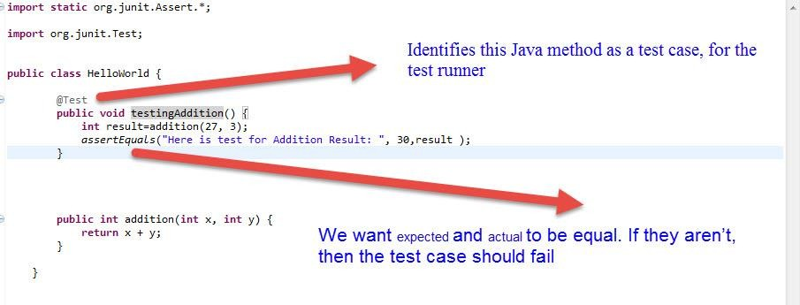
Example
Each @Test method represents a single test case that can independently have a verdict (pass, error, fail).

Slide 44
Assertions
Assertions are defined in the JUnit class Assert
If an assertion is true, the method continues executing.
If any assertion is false, the method stops executing at that point, and the result for the test case will be fail.
If any other exception is thrown during the method, the result for the test case will be error.
If no assertions were violated for the entire method, the test case will pass.
Note that only failed tests are reported.

Slide 45
assertTrue()
The following shows how assertTrue() works.
static public void assertTrue(Boolean condition) {
if (!condition)
throw new AssertionFailedError();
}
The assertTrue() assertion throws an exception

Slide 46
Calculator example
public class Calculator {
public int add(int a, int b) {
return a + b;
}
public int subtract(int a, int b) {
return a - b;
}
public int multiply(int a, int b) {
return a * b;
}
public int divide(int a, int b) {
return a / b;
}
}

Slide 47
Small JUnit test
public class CalculatorTest {
@Test public void add3and5Equals8() {
Calculator calc = new Calculator();
int result = calc.add(3, 5);
assertEquals(result, 8);
}
@Test(expected= java.lang.ArithmeticException.class)
public void divideByZeroThrowsException() {
Calculator calc = new Calculator();
int result = calc.divide(3,0);
}
@Test public void subtract5from6Equals2()
{
Calculator calc = new Calculator();
int result = calc.subtract(6, 5);
assertEquals(result, 2);
}
}

Slide 48
Organisation of Junit tests
Create test cases in the same package as the code under test
Methods with no annotation are not considered test cases, and can be used as helper methods.
Normally, all the tests for one Java class are grouped together into a separate class.
Make sure your build process includes the compilation of all tests
Naming convention:
Class to be tested: ClassX
Class containing tests: ClassXTest

Slide 49
Architecture overview
JUnit test framework is a package of classes that lets you write tests for each method, then easily run those tests
You test your class by extending abstract class TestCase
To write test cases, you need to know and understand the Assert class
TestRunner runs tests and reports TestResults

Slide 50
Why use JUnit?
JUnit tightly integrates development and testing
Allows you to write code faster while increasing quality!
Can refactor code without worrying about correctness.
JUnit is simple
Easy as running the compiler on your code.
JUnit tests check their own results and provide immediate feedback.
No manual comparison of expected with actual
Simple visual feedback
Writing JUnit tests is inexpensive
No harder than writing a method to exercise the code.
JUnit tests increase stability of software
More tests = more stability
Continue on next slide

Slide 51
JUnit tests are developer tests
Test fundamental building blocks of system
Tests delivered with code as a certified package
JUnit tests are written in Java
Seamless bond between test and code under test
Test code can be refactored into software code and vice-versa
JUnit is free!

Slide 52
When should we use JUnit
As the name implies…
for unit testing of small amounts of code in the test-driven development methodology,
a JUnit test should be written first before any code.
Then, implementation code should be written that would be the minimum code required to get the test to pass – and no extra functionality.
Once the code is written, re-execute the test and it should pass.
Every time new code is added, re-execute all tests again to be sure nothing gets broken.

Slide 53
JUnit example
The program presented solves the problem of representing arithmetic with multiple currencies.
Pay attention to the interplay of the code and the tests.
The style: to write a few lines of code, then a test that should run,
or even better: to write a test that won't run, then write the code that will make it run.

Slide 54
JUnit example
Define MoneyTest as a subclass of TestCase.
Put MoneyTest in the same package as the classes under test
Add method testSimpleAdd, that will exercise the simple version of Money.add() above.
A JUnit test method is an ordinary method without any parameters.

Slide 55
Problem statement
Representing arithmetic with multiple currencies
You cannot just convert one currency into another for doing arithmetic since
there is no single conversion rate
you may need to compare the value of a portfolio at yesterday's rate and today's rate

Slide 56
class Money {
private int fAmount;
//ISO three letter abbreviation (USD, CHF, etc.). private String fCurrency;
public Money(int amount, String currency){
fAmount= amount;
fCurrency= currency;
}
public int amount() {
return fAmount;
}
public String currency() {
return fCurrency;
}
public Money add(Money m) {
return new Money(amount()+m.amount(),currency()); }
}

Slide 57
equals in class Money
public boolean equals(Object anObject)
{
if (anObject instanceof Money){
Money aMoney= (Money)anObject;
return aMoney.currency().equals(currency())
&& amount() == aMoney.amount();
}
return false;
}

Slide 58
When you add two Moneys of the same currency, the resulting Money has as its amount the sum of the other two amounts
public class MoneyTest extends TestCase {
//…
public void testSimpleAdd() {
Money m12CHF= new Money(12, "CHF"); // (1)
Money m14CHF= new Money(14, "CHF");
Money expected= new Money(26, "CHF");
Money result= m12CHF.add(m14CHF); // (2)
assert(expected.equals(result)); // (3)
}
}
Code which creates the objects we will interact with during the test. This testing context is commonly referred to as a test's fixture.
Code which exercises the objects in the fixture.
Code which verifies the result.

Slide 59
Two Monies are considered equal if they have the same currency and value
public void testEquals() {
Money m12CHF= new Money(12, "CHF");
Money m14CHF= new Money(14, "CHF");
assert(!m12CHF.equals(null));
assertEquals(m12CHF, m12CHF);
assertEquals(m12CHF, new Money(12, "CHF")); // (1)
assert(!m12CHF.equals(m14CHF)); }
assert
triggers a failure that is logged by JUnit when the argument isn't true.
assertEquals
testing for equality with equals,
logs the printed value of the two objects in the case they differ.
Notes:
Swiss Franc

Slide 60
Common fixture
some code duplication for setting-up the tests.
the setUp method
to reuse some of this test set-up code.
With JUnit you can do so by storing the fixture's objects in instance variables of your TestCase class
initialize them by overridding the setUp method.
the tearDown method
the symmetric operation to setUp
override to clean up the test fixture at the end of a test.
Each test runs in its own fixture
JUnit calls setUp and tearDown for each test
there can be no side effects among test runs

Slide 61
Rewriting of tests – removing duplicate code
public class MoneyTest extends TestCase {
private Money f12CHF;
private Money f14CHF;
protected void setUp() {
f12CHF= new Money(12, "CHF");
f14CHF= new Money(14, "CHF");
}
public void testEquals() {
assert(!f12CHF.equals(null));
assertEquals(f12CHF, f12CHF);
assertEquals(f12CHF, new Money(12, "CHF"));
assert(!f12CHF.equals(f14CHF)); }
public void testSimpleAdd() {
Money expected= new Money(26, "CHF");
Money result= f12CHF.add(f14CHF);
assert(expected.equals(result)); }
protected void tearDown() {
f12CHF= null;
f14CHF= null;
}
}

Slide 62
Running single tests
Static
In the static way you override the runTest method and define the method to be invoked.
TestCase test= new MoneyTest("simple add"){
public void runTest( {
testSimpleAdd();
}
};
Dynamic
uses reflection to implement runTest. It dynamically finds and invokes a method. In this case the name of the test case has to correspond to the test method to be run.
TestCase test= new MoneyTest("testSimpleAdd");

Slide 63
Test suite
A TestSuite can run a collection of tests.
TestSuite and TestCase both implement an interface called Test which defines the methods to run a test.
This enables the creation of test suites by composing arbitrary TestCases and TestSuites.
public static Test suite() {
TestSuite suite= new TestSuite();
suite.addTest(new MoneyTest("testEquals"));
suite.addTest(new MoneyTest("testSimpleAdd"));
return suite;
}

Slide 64
Static test suite
public static Test suite() {
TestSuite suite= new TestSuite();
suite.addTest(new MoneyTest("money equals") {
protected void runTest() {
testEquals(); }
}
);
suite.addTest( new MoneyTest("simple add") {
protected void runTest() {
testSimpleAdd(); }
}
);
return suite;
}

Slide 65
Dynamic test suite
Only pass the class with the tests to a TestSuite
It extracts the test methods automatically
public static Test suite() {
return new TestSuite(MoneyTest.class);
}

Slide 66
Mixed currency arithmetic
there isn't a single exchange rate.
To avoid this problem we introduce a MoneyBag which defers exchange rate conversions.
class MoneyBag {
private Vector fMonies= new Vector();
MoneyBag(Money m1, Money m2) {
appendMoney(m1);
appendMoney(m2);
}
MoneyBag(Money bag[]) {
for (int i= 0; i < bag.length; i++)
appendMoney(bag[i]);
}
}

Slide 67
appendMoney
adds a Money to the list of Moneys
takes care of consolidating Monies with the same currency.

Slide 68
Testing MoneyBag
protected void setUp() {
f12CHF= new Money(12, "CHF");
f14CHF= new Money(14, "CHF");
f7USD= new Money( 7, "USD");
f21USD= new Money(21, "USD");
fMB1= new MoneyBag(f12CHF, f7USD);
fMB2= new MoneyBag(f14CHF, f21USD);
}
public void testBagEquals() {
assert(!fMB1.equals(null));
assertEquals(fMB1, fMB1);
assert(!fMB1.equals(f12CHF));
assert(!f12CHF.equals(fMB1));
assert(!fMB1.equals(fMB2));
}

Slide 69
public Money add(Money m) {
if (m.currency().equals(currency()) )
return new Money( amount()+m.amount(),
currency());
return new MoneyBag(this, m);
}

Slide 70
Now two representations for Moneys : Money and MoneyBag
we would like to hide them from the client code.
To do so we introduce an interface IMoney that both representations implement.
interface IMoney {
public abstract IMoney add(IMoney aMoney);
//…
}

Slide 71
The common interface for simple Monies and MoneyBags
interface IMoney {
public abstract IMoney add(IMoney m);
/**
* implementing double dispatch
*/
IMoney addMoney(Money m);
IMoney addMoneyBag(MoneyBag s);
public abstract boolean isNull();
public abstract IMoney multiply(int factor);
public abstract IMoney negate();
public abstract IMoney subtract(IMoney m);
}

Slide 72
Tests for the addition of Monies
public void testMixedSimpleAdd() {
// [12 CHF] + [7 USD] == {[12 CHF][7 USD]}
Money bag[]= { f12CHF, f7USD };
MoneyBag expected= new MoneyBag(bag);
assertEquals(expected, f12CHF.add(f7USD));
}
The other tests follow the same pattern:
testBagSimpleAdd - to add a MoneyBag to a simple Money
testSimpleBagAdd - to add a simple Money to a MoneyBag
testBagBagAdd - to add two MoneyBags

Slide 73
Test suite for MoneyBag
public static Test suite() {
TestSuite suite= new TestSuite();
suite.addTest(new MoneyTest("testMoneyEquals"));
suite.addTest(new MoneyTest("testBagEquals"));
suite.addTest(new MoneyTest("testSimpleAdd"));
suite.addTest(new MoneyTest("testMixedSimpleAdd"));
suite.addTest(new MoneyTest("testBagSimpleAdd"));
suite.addTest(new MoneyTest("testSimpleBagAdd"));
suite.addTest(new MoneyTest("testBagBagAdd"));
return suite;
}

Slide 74
JUnit review
A little test, a little code, a little test, a little code…
Capture your thoughts in a test
Keeping old tests running is just as important as making new ones run.
Whenever you are tempted to type something into a print statement or a debugger expression, write it as a test instead
A style of testing that with a remarkably small investment will make you a faster, more productive, more predictable, and less stressed developer.

Slide 75
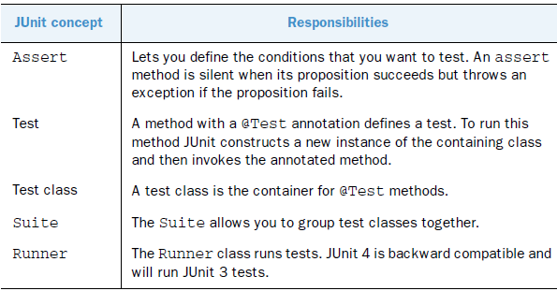
JUnit core objects

Slide 76
Running Tests
Running a TestCase runs all its public testXXX() methods
Running a TestSuite runs all its TestCases and subordinate TestSuites.

Slide 77
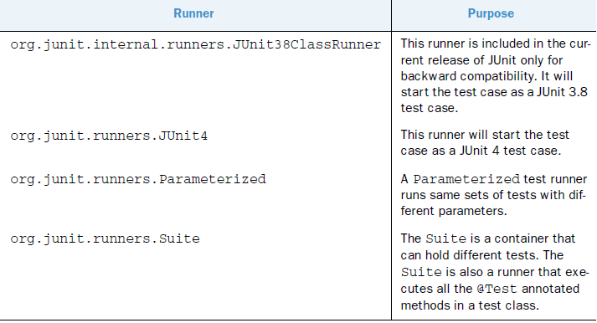
Runner (or test runner)
The runner class runs test.
JUnit provides various runners to execute your tests.

Slide 78
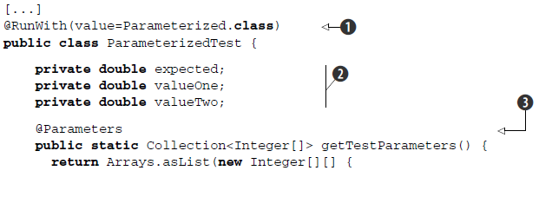
Running parameterized tests
The Parameterized test runner allows you to run a test many times with different sets of parameters.

Slide 79
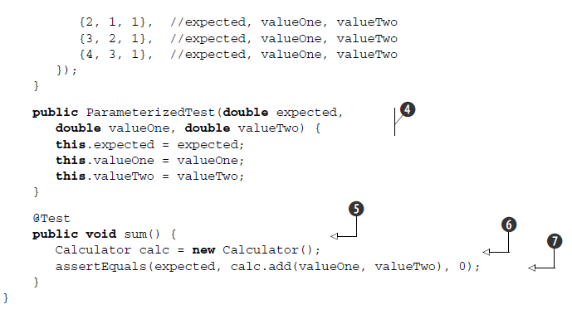

Slide 80
Requirements of parameterized test
To run a test class with the Parameterized test runner, you must meet the following requirements.
The test class must carry the @RunWith annotation with the Parameterized class as its argument.
You must declare instance variables used in the tests
provide a method annotated with @Parameters
The signature of this method must be
public static java.util.Collection, without parameters

Slide 81
Cont.
The Collection elements must be arrays of identical length (One array is an element of the Collection).
This array length must match the number of arguments of the only public constructor.
In our case, each array contains three elements because the public constructor has three arguments.
Our example uses this method to provide the input and expected output values for the tests.
Because we want to test the add method of our Calculator program, we provide three parameters: expected value and two values that we add together.

Slide 82
Cont.
4) we specify the required constructor for the test. Note that this time our test case doesn’t have a no-argument constructor but instead has a constructor that accepts parameters for the test.
5) we finally implement the sum @Test method
6) Instantiate the Calculator program
7) Assert calls for the parameters we’ve provided

Slide 83
Running the test
Running this test will loop exactly as many times as the size of the collection returned by the @Parameters method.
The execution of this single test case has the same result as the execution of the following test cases with different parameters:
sum: assertEquals(2, calculator.add(1, 1), 0);
sum: assertEquals(3, calculator.add(2, 1), 0);
sum: assertEquals(4, calculator.add(3, 1), 0);

Slide 84
Features of JUnit
It is an open source framework.
Provides Annotation to identify the test methods.
Provides Assertions for testing expected results.
Provides Test runners for running tests.
JUnit tests can be run automatically and they check their own results and provide immediate feedback.
JUnit tests can be organized into test suites containing
test cases and even other test suites.

